Slide 1

“NEW YORK CITY RESTAURANT FOOD SAFETY”
CUT FAMELIA - SHAOWEI GONG - SHILE ZHAO - ZHAOJUN YANG

Slide 2

FOOD SAFETY AWARENESS

Slide 3
GRADING SYSTEM
A = 0 – 13 points (excellent food safety practices)
B = 14 – 27 points
C = 28 points or more

Slide 4
QUESTIONS
1. How much the inspections affect the restaurant food safety practices?
2. How the rank of every restaurant type looks like?
3. Which type of restaurants have the highest rate of food safety?
4. Which type of restaurants have the lowest rate of food safety?
5. How every restaurant type’s grade performance looks like based on location and period of time?

Slide 5
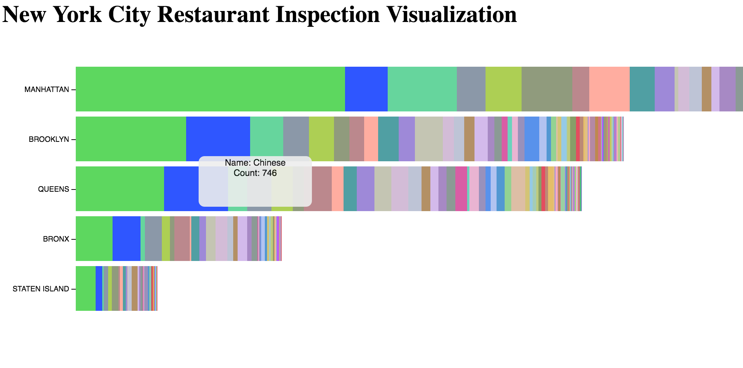
Visualization #1

Slide 6
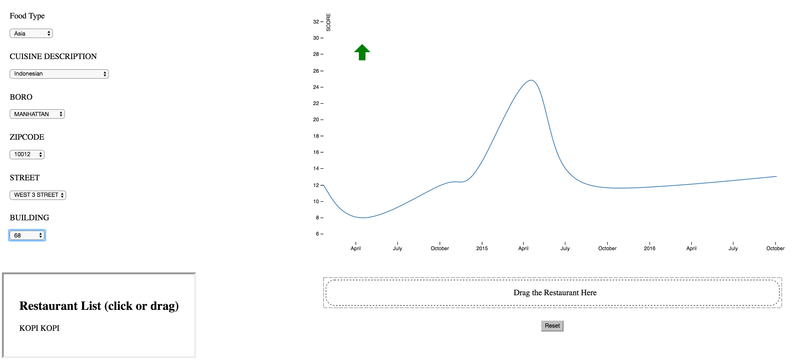
Visualization #2

Slide 7
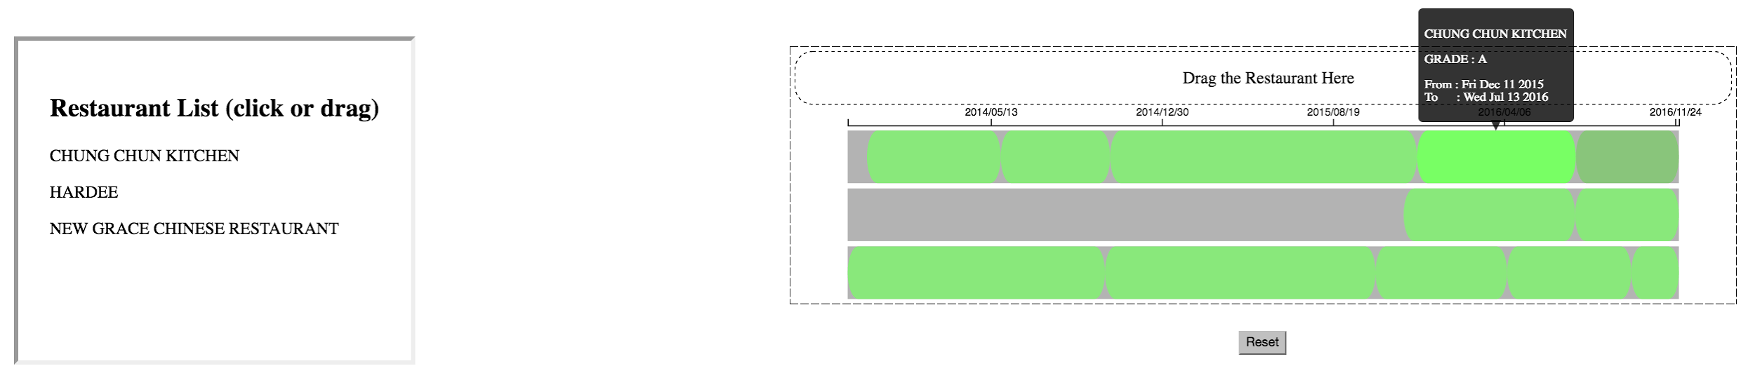
Visualization #3

Slide 8
Visualization #4 & #5
Under construction

Slide 9
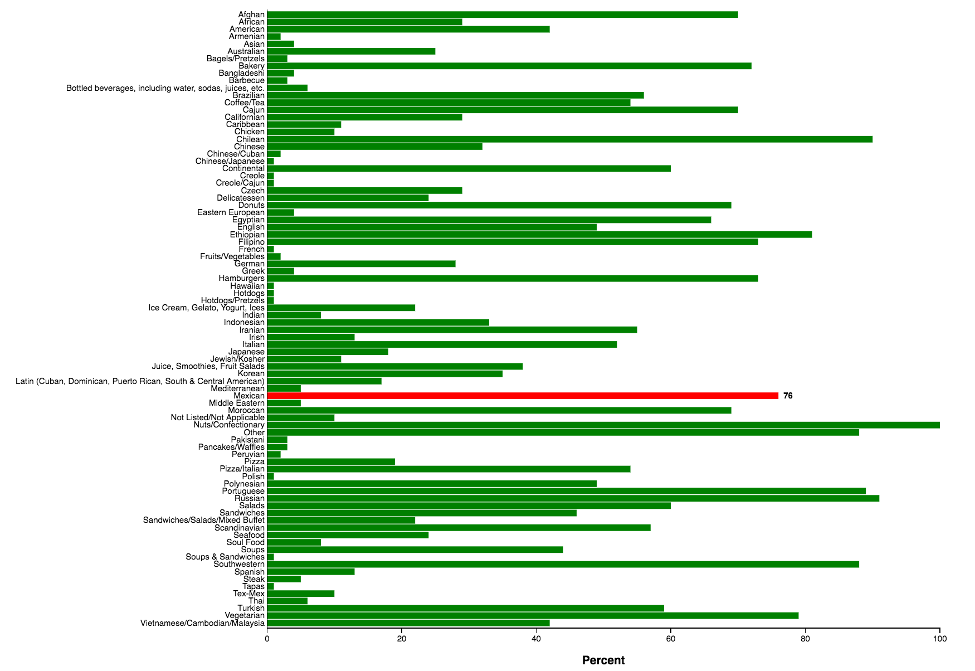

Slide 10
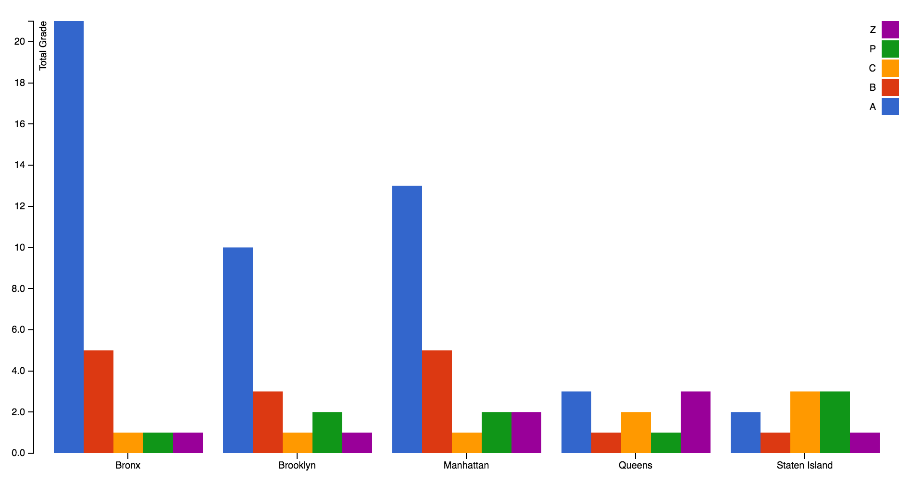

Slide 11
Let’s try it!
https://1nfo.github.io/DataVisFinal/

Slide 12
THANK YOU

